Slide 1

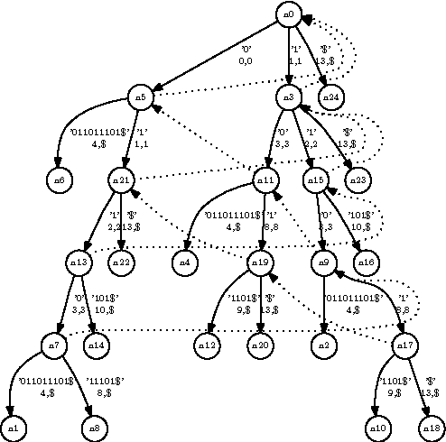
Ukkonen’s Algorithm
Presented by: Jarette Greene
Slideshow created by: Jarette Greene

Slide 2
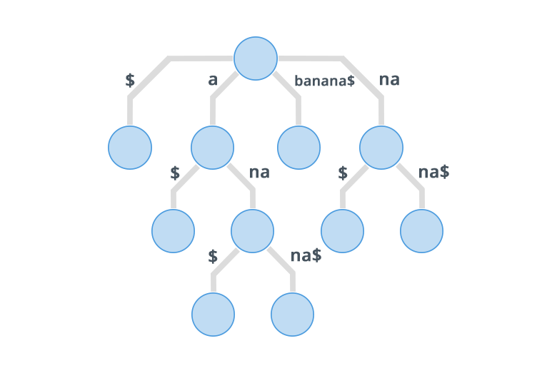
Suffix Tree
root
Is a compressed trie tree of all the suffixes of a given string
for example lets pass in the word “banana$”
List of all suffix’s in the banana$
banana$
anana$
nana$
ana$
na$
a$
$
7
1
6
5
3
4
2

Slide 3
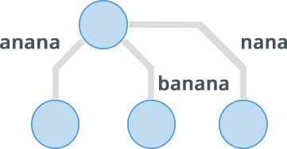
Implicit Suffix Tree and Terminator character
Terminator Character: This us a character appended to the end of the inserted string to ensure that every suffix to have its own branch in the tree.
The terminator character has to be a character that cannot be found in any other parts of the string in our case we use the character “$”
Implicit Suffix tree: This is a suffix tree that does not append a terminator character to the string. This creates a tree where suffixes that appear within previous suffixes will not appear in the tree.
The problem with this tree is that in cases of many repeating substrings can be lost.

Slide 4
Inserting into a Suffix Tree. (Brute Force)
Steps for Inserting into a suffix tree
1) append unique character to the string you would like to insert
2) Perform normal Trie tree insert by inserting each suffix one at a time
Start recursive compression algorithm (starting at the root as the current node)
3) If the current node has a single child that is not a leaf node, merge the current node with its child, (concatenate characters) Update any relevant information
4) If the current node has multiple children, check if any of the children share the same edge label if so megre those children by concatenating label
5) of the current node is a leaf node ot multiple children with distinct edges, move on to the next child and repeat step 3 and 4
6)Once all children of rhe current node have been processed move onto the next child.
7) Repeat steps until completely processed

Slide 5
Creating suffix Tree “Banana$”
filling suffix tree with all suffixes
a
$
banana$
anana$
nana$
ana$
na$
a$
$
b
n
7
n
$
a
a
a
$
n
6
n
$
n
5
a
a
a
4
$
n
$
2
a
3
$
1

Slide 6
Compressing a the Tree
a
$
b
n
7
n
$
a
a
a
$
n
6
n
$
n
5
a
a
a
4
$
n
$
2
a
3
$
1

Slide 7
Compressing a the Tree
a
$
b
n
7
n
merge
$
a
a
a
$
n
6
n
$
n
5
a
a
a
4
$
n
$
2
a
3
$
1

Slide 8
Compressing a the Tree
a
$
b
na
7
n
$
a
n
a
$
$
6
n
n
a
4
5
a
a
$
n
$
2
a
3
$
1

Slide 9
Compressing a the Tree
a
$
b
na
7
n
$
a
n
a
merge
$
$
6
n
n
a
4
5
a
a
$
n
$
2
a
3
$
1

Slide 10
Compressing a the Tree
a
$
b
na
7
n
$
a
a
merge
na
$
$
6
n
n
$
4
5
a
a
2
n
$
a
3
$
1

Slide 11
Compressing a the Tree
a
$
b
na
7
n
$
merge
a
a
na$
$
$
6
n
n
2
4
5
a
a
n
$
a
3
$
1

Slide 12
Compressing a the Tree
a
$
ba
na
7
n
$
merge
n
a
na$
$
$
6
a
n
2
4
5
n
a
a
$
$
3
1

Slide 13
Compressing a the Tree
a
$
ban
na
7
n
$
merge
a
a
na$
$
$
6
n
n
2
4
a
5
$
a
1
$
3

Slide 14
Compressing a the Tree
a
$
bana
na
7
n
$
merge
n
a
na$
$
$
6
a
n
2
4
$
5
a
1
$
3

Slide 15
Compressing a the Tree
a
$
banan
na
7
n
$
merge
a
a
na$
$
$
6
$
n
2
4
5
1
a
$
3

Slide 16
Compressing a the Tree
a
$
banana
na
7
n
$
$
merge
a
na$
$
$
6
1
n
2
4
5
a
$
3

Slide 17
Compressing a the Tree
a
$
banana$
na
7
n
$
merge
1
a
na$
$
$
6
n
2
4
5
a
$
3

Slide 18
Compressing a the Tree
a
$
banana$
na
7
na
$
$
1
na
na$
merge
5
$
6
$
2
4
3

Slide 19
Compressing a the Tree (Complete)
a
$
banana$
7
na
na
$
na$
$
1
na$
5
$
6
3
2
4

Slide 20
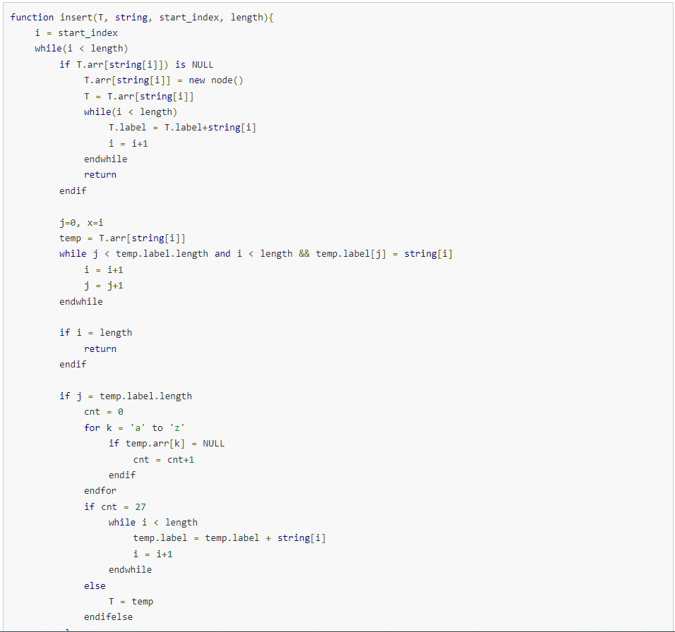
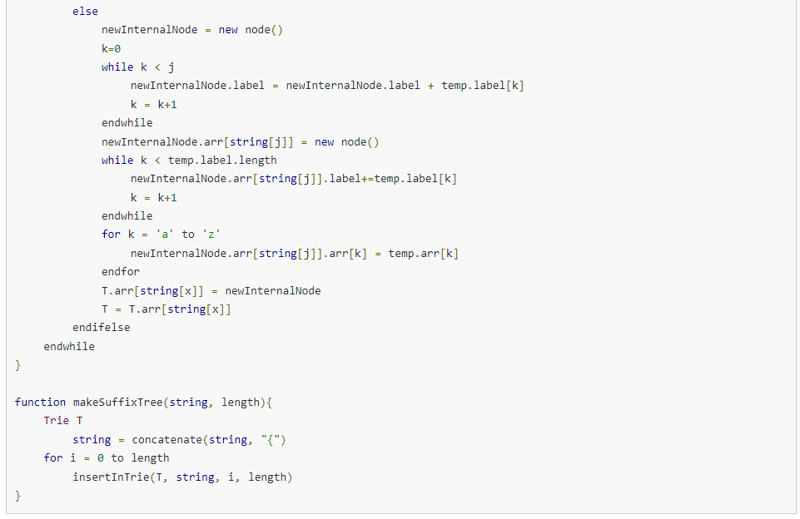
PsuedoCode for Brute Force Implementation

Slide 21
Complexity
The suffix (compressed trie) tree has a space complexity of O(n) which is an improvement compared to a standard trie tree which is O(n^2).
The time complexity of a suffix (compressed trie) tree varies based on implementation.
Insertion:
using the brute force method of insertions is O(n^2). This is because this method involves inserting each suffix of a given string one at a time.
there are algorithms im prove this time. For example Ukkonen’s Algorithm.

Slide 22

Ukkonen’s Algorithm
This is an algorithm used to insert a string into a suffix (compressed trie) the at improves on the brute force (On^2) approach
this alorigrithm is categorized as an incremental and online algorithm with Linear time complexity (O(n))
This is possible because this algorthm rather then inserting each suffix individually it processes the string as it is inserted to find each suffix and place them into the correct position.
This algorithm was proposed by Esko Ukkonen in 1995

Slide 23
High Level Description
Suffix extension is all about adding the next character into the suffix tree built so far. In extension j of phase i+j , algorithm finds the end of S[j..i] (which is already in the tree due to previous phase i) and then it extends S[j...i] to be sure the suffx S[j...i+1] is in the tree. There are three extension rules:
1) if the pathfrom the root labelled S[j..i] ends at a leaf edge( i.e., S[i] is last character on leaf edge), the character S[i+1], then character S[i+1] is just added to the end of the label on that leaf edge.
2) if the path from the root labelled S[j..i] ends at a non - leaf edge (i.e, thee are more character after S[i[ on path) and next character is not S[i+1], then a new leaf edge with label S[i+1] and number j is created starting from character S[i+1]. A new internal node will also be created if S[1..i] ends inside (in between) a non-leaf leaf edge.
3) if the paath from the root labelled S[j..i] ends at a non-leaf edge (i.e.,, there are more character after S[i] on path) and next character is S[i+1] (already in tree, do nothing.
One important point to note is that from a given node (root or internal), there will be one and only ine edge starting from one character. There will not be more than one edge going out of any node starting with the same character

Slide 24
Example
We will be creating a suffix tree of the string “bananasna$”
values and pointers being tracked throughout:
step / i : #
Remainder : #
active_lenght: #
active_node:
active _ edge:
Suffix Link:

Slide 25
Values:
Step: 1
Remainder: 0
Active_length: 0
character being inserted:
b a n a n a s n a $
b
1
Steps taken:
root created and inserted the character b and attach it to the root.

Slide 26
Values:
Step: 2
Remainder: 0
Active_length: 0
character being inserted:
b a n a n a s n a $
a
ba
2
1
Steps taken:
since there is no edges that start with “a”
add another edge “a” and append “a” unto all edges that lead to a leaf node.
note to calculate the value inside of the left node
it is Steps/i - Active_length

Slide 27
Values:
Step: 3
Remainder: 0
Active_length: 0
character being inserted:
b a n a n a s n a $
an
ban
n
2
1
3
Steps taken:
since there is no edge that starts with n
add another edge “n” and append “n” unto all edges that lead to a leaf node.

Slide 28
Values after processing
Step: 4
Remainder: 1
Active_length: 1
character being inserted:
b a n a n a s n a $
a|na
banan
nan
2
1
3
Steps taken:
increment remainder and step and append “a” onto all edges that lead to a leaf
now check if any node attached to the root starts with “a”. Yes so, do not insert new edge and update active_node, active_edge, and increment active length

Slide 29
Values after processing
Step: 5
Remainder: 2
Active_length: 2
character being inserted:
b a n a n a s n a $
an|an
banan
nan
2
1
3
Steps taken:
Nb = since we didnt successfully insert we are now trying to insert (“n” and “an”.
increment remainder and step and append “n” onto all edges that lead to a leaf
now you check the active edge to see if the it starts with “n”. Yes so you update the active_edge, active_node(this case it stays where it is) then increment the active lenght

Slide 30
Values after processing
Step: 6
Remainder: 3
Active_length: 3
character being inserted:
b a n a n a s n a $
an|ana
banana
nana
2
1
3
Steps taken:
Nb = since we didnt successfully insert we are now trying to insert (“a”, “an”, “ana”).
increment remainder and step and append “a” onto all edges that lead to a leaf
now you check the active edge to see if the it starts with “a”. Yes so you update the active_edge, active_node(this case it stays where it is) then increment the active lenght

Slide 31
Values after processing
Step: 7
Remainder: 3
Active_length: 3
character being inserted:
b a n a n a s n a $
ana
bananas
nanas
1
3
Steps taken:
Nb = insert we are now trying to insert (“s”, “as”, “nas”, “anas”,).
increment remainder and step and append “s” onto all edges that lead to a leaf
check if the active_edge starts with “n”. No, then create an internal node with its child being the current insert “n” (with the leaf node follwing) and the remaining string from the active_edge and calculate the new leaf node value. then decrement, active_lenght and remainder.
nas
s
2
4

Slide 32
Values after processing
Step: 7
Remainder: 3
Active_length: 2
character being inserted:
b a n a n a s n a $
ana
bananas
na|nas
1
3
Steps taken:
Nb = insert we are now trying to insert (“s”, “as”, “nas”). and still on step 7 so no incrementing step or remainder. currently inserting “nas”
now decrement active lenght 2 and then check for the edge that starts with “n” then move the active edge two positions after and keep active node where it is.
nas
s
2
4

Slide 33
Values after processing
Step: 7
Remainder: 2
Active_length: 1
character being inserted:
b a n a n a s n a s $
ana
bananas
na
1
nas
s
nas
s
Steps taken:
Nb = insert we are now trying to insert (“s”, “as”, “nas”). and still on step 7 so no incrementing step or remainder. currently inserting “nas”
now we try adding “nas” by inserting “s” which causes us to have to create a new internal node similar to previous step then decrementing remainder and active node
2
4
3
5

Slide 34
Values after processing
Step: 7
Remainder: 2
Active_length: 1
character being inserted:
b a n a n a s n a s $
a|na
bananas
na
1
nas
s
nas
s
Steps taken:
Note if during a single step if multiple internal nodes are created then you would create something called a suffix links which is just a pointer that points from one internal node to another internal node
Nb: (“s”, “as”) trying to insert “as”
now we continue by updating the active node which remains in the same position, and check all edges to see which one starts with an “a” then move the edge one position
2
4
3
5

Slide 35
Values after processing
Step: 7
Remainder: 1
Active_length: 0
character being inserted:
b a n a n a s n a s $
a
bananas
na
1
s
nas
s
Steps taken:
Nb: (“s”, “as”) trying to insert “as” by inserting s.
now like a previous step you check to see the next position after the active edge is not “s” so you insert another internal node (remember suffix links)
then decrement remainder and
active length
na
6
3
5
nas
s
2
4

Slide 36
Values after processing
Step: 7
Remainder: 0
Active_length: 0
character being inserted:
b a n a n a s n a s $
s
a
bananas
na
7
1
s
nas
s
Steps taken:
NB: Now trying to insert the remaining “s”.
check for “s” at the begining of each edge from the active node. No so we insert attached to the active node and give it a leaf node.
Decrement remainder and since
remainder is 0 you set the active edge to null
na
6
3
5
nas
s
2
4

Slide 37
Values after processing
Step: 8
Remainder: 1
Active_length: 1
character being inserted:
b a n a n a s n a s $
sn
a
bananasn
n|a
7
1
sn
nasn
sn
Steps taken:
Now we can move onto the next step
and insert “n”
increment remainder
so we append “n” to all edeges with leaf nodes. then check for any nodes
from root that start with “n”, Yes
then update active values where
active node is root, update active edge and increment active length
na
6
3
5
nasn
sn
2
4

Slide 38
Values after processing
Step: 9
Remainder: 2
Active_length: 2
character being inserted:
b a n a n a s n a s $
sna
a
bananasna
na
7
1
sna
nasna
sna
Steps taken:
Now we can move onto the next step
and insert (“na” , “a”)
increment remainder
we append “a” to all edges with leaf nodes and now check the active edge to see if the character after
after active edge node is “a”. Yes,
so we update active data so active node remains and active edge is updated and active lenght is incremented. HOWEVER, since the active edge would move to the end of the edge the active node would move the the next internal node an the active_length becomes 0
na
6
3
5
nasna
sna
2
4

Slide 39
Values after processing
Step: 10
Remainder: 2
Active_length: 0
character being inserted:
b a n a n a s n a $
sna$
a
bananasna$
na
7
1
sna$
nasna$
sna$
$
Steps taken:
Now we can move onto the next step
and insert (“na$” , “a$”, “$”)
increment remainder and append “$” to all edges with leaf node. Now check if any node after the active node begins with “$”. No so we
insert.
then decrement remainder
NB: the active lenght to create the leaf uses the active lenght before the active node was moved.
na
6
3
5
8
nasna$
sna$
2
4

Slide 40
Values after processing
Step: 10
Remainder: 2
Active_length: 0
character being inserted:
b a n a n a s n a $
sna$
a
bananasna$
na
$
7
1
9
nasna$
sna$
$
Steps taken:
Now after inserting onto a node that isnt the root we move to the next internal node it is pointing too which using suffix links
now we insert “a$” by checking if any edges start with “$”. Yes so we
perform an insert. decrement remainder note still using the
previous active length that should be
1.
Since we have no active edge and has no suffix links the active node is the root
na
sna$
6
3
5
8
nasna$
sna$
2
4

Slide 41
Values after processing
Step: 10
Remainder: 0
Active_length: 0
character being inserted:
b a n a n a s n a $
sna$
$
a
bananasna$
na
7
10
$
1
9
nasna$
sna$
$
Steps taken:
Now inserting “$”. check if any edge
attached to root begins with “$”. NO
perform an insert and decrement
Then the tree is complete because there is no more character to be added
na
sna$
6
3
5
8
nasna$
sna$
2
4

Slide 42
COMPLETE TREE
sna$
$
a
bananasna$
na
7
10
$
1
9
nasna$
sna$
$
na
sna$
6
3
5
8
nasna$
sna$
2
4

Slide 43
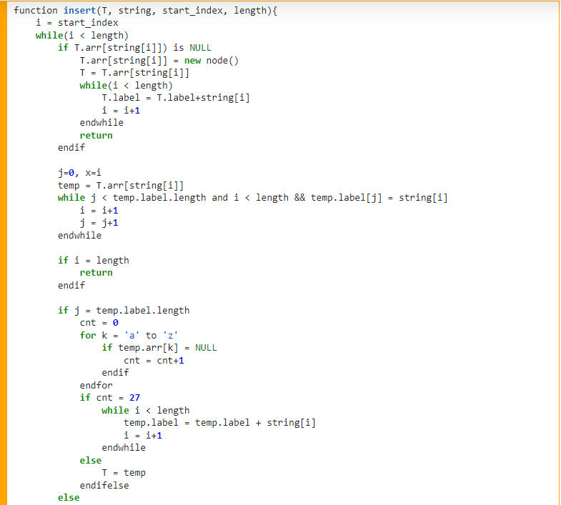
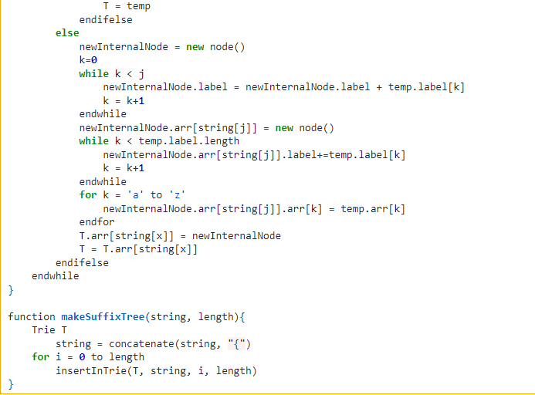
PsuedoCode for Ukkonen’s Algorithm

Slide 44
Applications of Suffix Trees
1) String Search: A fast wat to search for a string inside of text
2) Longest substring: used to find common substring quickly
3) Bioinformatics: tasks like DNA Sequnece alignment, finding repetive DNA requesnce, inentifying genes etc
4) Data compression
5) Natural Language Processing: eg text summarization, part-of-speech taging, named entity recognition,etc
6) Spell Checking
7) Data Mining and Information retrieval
8) Computational Biology
9) Network Analysis

Slide 45
Work Cited
https://en.wikipedia.org/wiki/Ukkonen%27s_algorithm#:~:text=In%20computer%20science%2C%20Ukkonen's%20algorithm,first%20character%20of%20the%20string.
https://www.enjoyalgorithms.com/blog/suffix-tree-data-structure
https://www.hackerearth.com/practice/data-structures/advanced-data-structures/suffix-trees/tutorial/
https://favtutor.com/blogs/ukkonen-algorithm-suffix-tree
https://www.youtube.com/watch?v=ALEV0Hc5dDk
Honarable Mentions:
ChatGPT.

